Slide 1
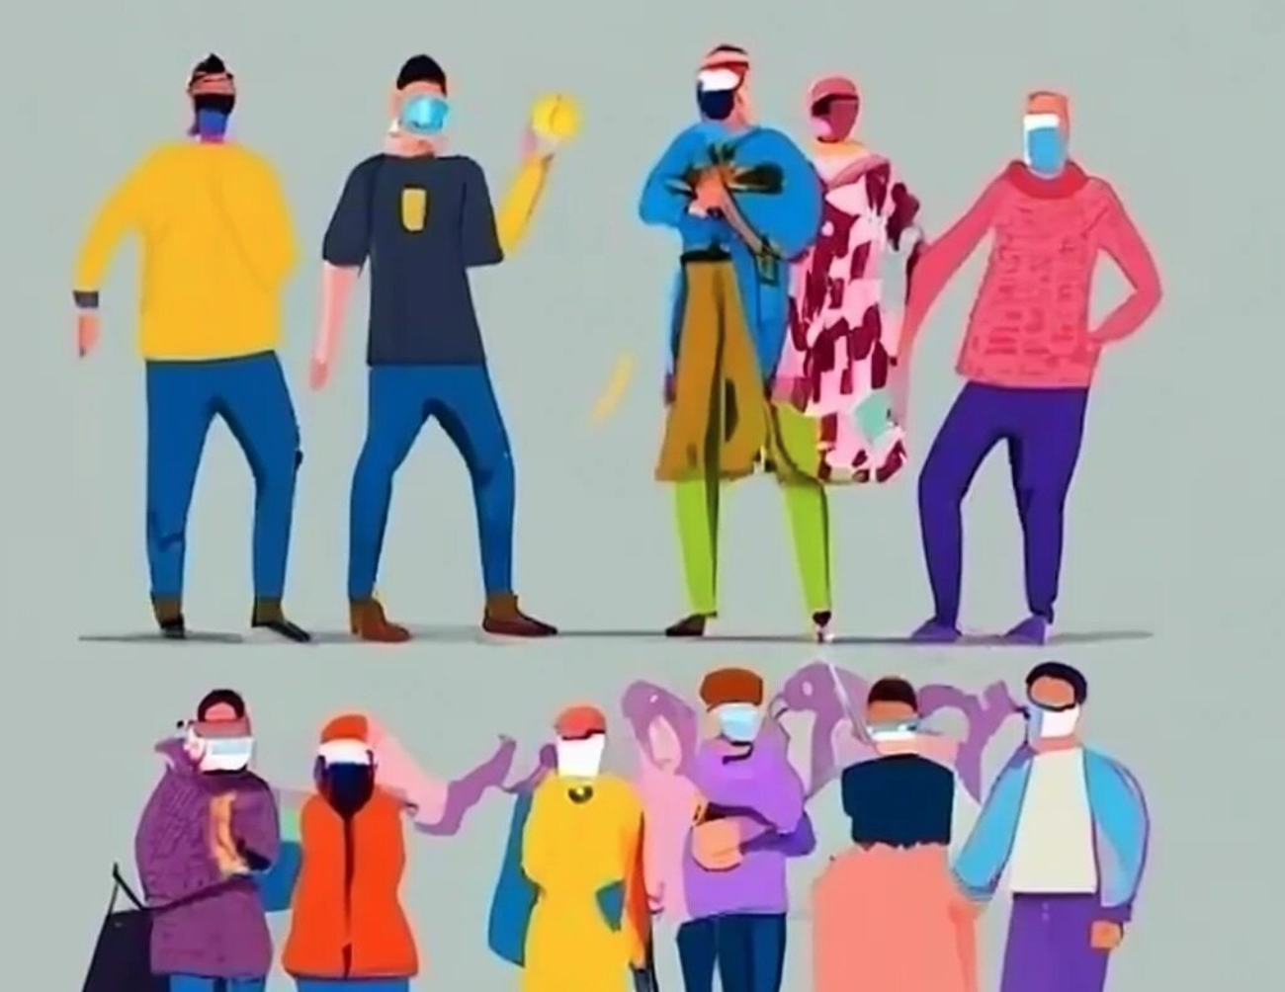
THE COVID GENERATION Identifying risks and protective factors for young people’s pathways through the COVID-19 pandemic in Switzerland
Update on research progress and potential contributions to Booklet No. 2: Well-being and Life Trajectories

Slide 2
Project Team
Dr. Dawid Gondek
FORS
Postdoctoral researcher
Teuta Mehmeti
University of Neuchatel
Junior researcher
Dr. Marieke Voorpostel
FORS
PI
Prof. Núria Sánchez Mira
University of Neuchatel
Co-PI
Prof. Stephanie Steinmetz
University of Lausanne
Co-PI
Prof. Leen Vandecasteele
University of Lausanne
Co-PI

Slide 3
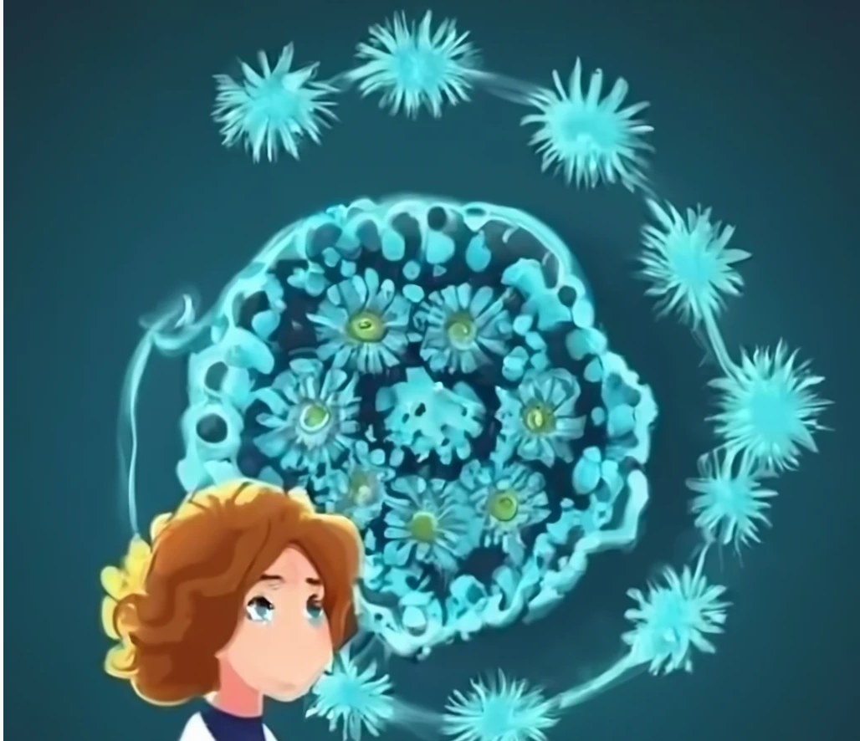
Research questions
Wellbeing of young people
Policy response
[add image]
To what extent did the COVID-19 pandemic affect wellbeing of young people in the short and medium term?
What were the main drivers, the groups most at risk and which protective factors mitigated negative consequences for wellbeing?
Were policy initiatives to support young people during the pandemic focusing on the groups most at risk?
What can we learn from the design and implementation of those initiatives for future crises?

Slide 4
Current state of research
General
Exchange with Policy Advisory Board
Outreach
Preparing for policy report
WP1 Wellbeing
Papers published and in progress
New: wellbeing of children in care
Importance of parents’ experience of the pandemic for children’s wellbeing
WP2
Policy Inventory
Federal/National level
Cantonal Level: VD, ZH, VS, SG
Next cantons: TI, eventually AI and AR
Interviews conducted with 27 experts
Federal level: 10 experts
Cantonal level: 17 experts
Next interviews: SG, TI, AI, and AR
Notes:
WP1
Published:
Composite wellbeing measure SHP
Descriptive wellbeing trends
Under review:
Pandemic experience and negative affect
In progress:
Cohort comparison
Policy Inventory (on policies, programmes supporting, promoting and preventing young people's well-being and mental health)

Slide 5
Potential contribution to Booklet No. 2: Well-being and Life Trajectories
Findings WP1
Findings WP2
Wellbeing declined already pre-pandemic
Negative affect increased as pandemic endured
Heterogeneous effect:
Risk groups: young women, NEET, low income more vulnerable
More worry and stress during pandemic more negative affect in the longer term
Get input from vulnerable groups: Self-reports of children in care were more negative than carers’ reports
Holistic view of wellbeing: Important to include multiple domains of young people’s lives
Health includes mental health: consider the impact of measures on young people and their place in society
A more encompassing framework and funding at the federal level is needed to enhance possibilities for intervention
Cantonal autonomy appreciated, but can also prove challenging (multiplicity of approaches, inequality of ressources…)
Notes:
NEET entry and exit more negative than pre-pandemic comparison
Poverty entry and consistently poor more negative
Positive short-term effect of increased physical activity
depending on who we ask during the crisis we may get a different message so it's always important to ask the children/young people themselves about their mental health particularly vulnerable populations.
WP2
Holistic vision of well-being and mental health: importance of taking into account all young people’s spheres of experience and main actors
+ allows to rely on buildung young people’s ressources, prevent a too quick «psychiatric» and clinical stance
- Not always easy to identify the key players and levers for supporting young people (families, parents, psychology services)
Not forgetting the impact of a pandemic on young people and their place in the society (intergenerational = also young people matter). Reflect on which aspects of health are at risk ➔ Young people's mental health was initially not seen as a priority and was underestimated. Youth well-being was already declining before (the pandemic worsened it, and at the same time allowed to destigmatise the issue of mental health)
Enhance the legal and structural framework at federal level to support young people
Heterogeneity of policy responses across cantons ➔ Cantonal freedom and independence mostly appreciated, but can also be a challenge (Inequalities in resources, different traditions, medical/versus “social approach”….)

